Slide 1

Cue Approach Task – Conversion to Python
Ido W, Naama Y, Lior A
Lidor M
Sagol School of Neuroscience,
Data Science Hackathon,
June 2018
[https://github.com/LiorArmon/Python-Hackathon]

Slide 2
Project Goal
Substituting CAT (Cue Approach Training) Matlab code
so it can be executed entirely from python

Slide 3
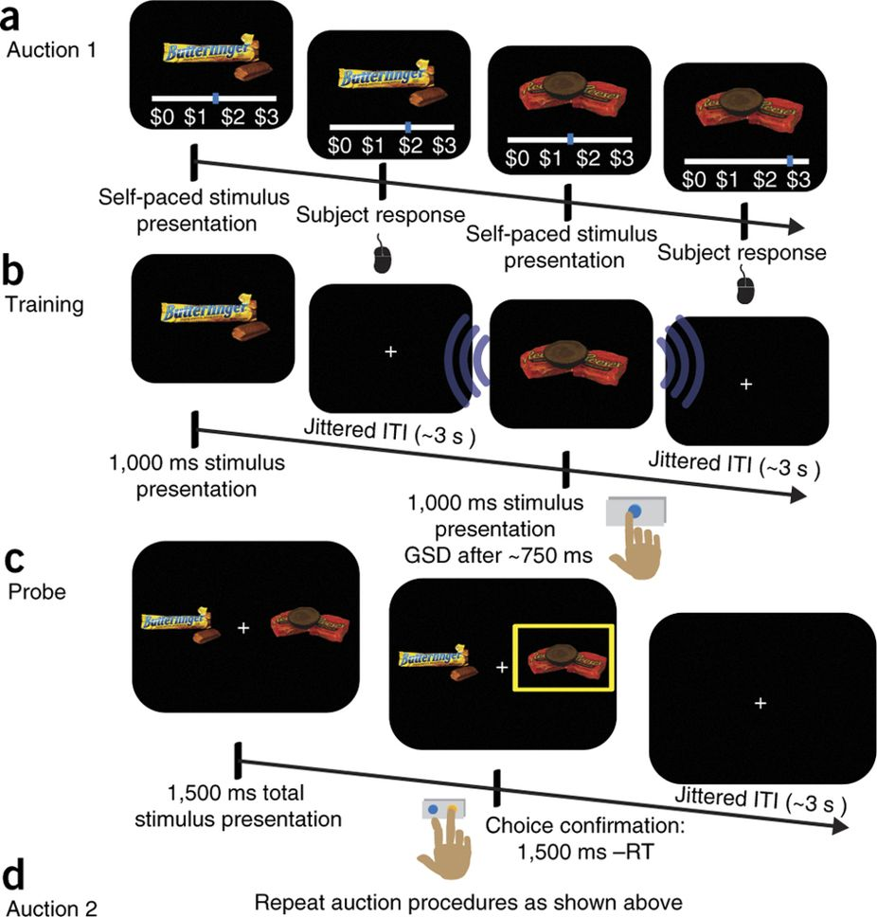
CAT Outline
BDM
Cue Approach Training
Probe

Slide 4
Major Project Components
Component 1: BDM sorting – [Ido] – ordering user preferences and allocating different values to items
Component 2: Training – [Lior & Lidor] – GUI:
fixation cross -> image(snack) -> cue/no cue-> fixation cross
The user should response using a key-press or not (based on cue) + saving the data
Component 3: Probe [Naama] – presenting 2 item comparisons based on Component 1 and recording preferences from user input

Slide 5
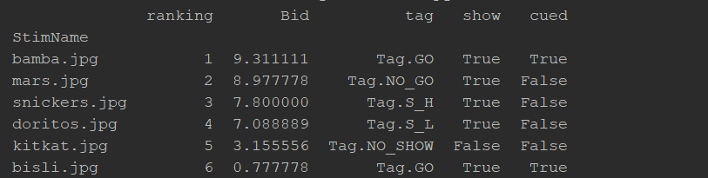
Components Output
multiindex DataFrame, where each block section contains snack name, RT from cue, success input count, which key pressed
Csv file that contains: index, go items index, no go item index, go item in left side?, go/no go item names, response, was go item chosen?
Training Features:
The game calls the block, each block runs all the trials (snacks) that exist in the dataframe produced from the first part. Each trial is composed of: time intervals (pre_cue, itis) change each trial according to user input.
various features are mutable

Slide 6
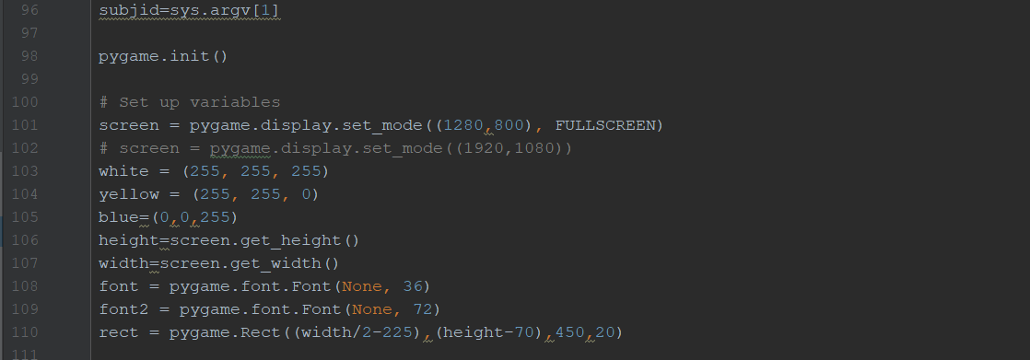
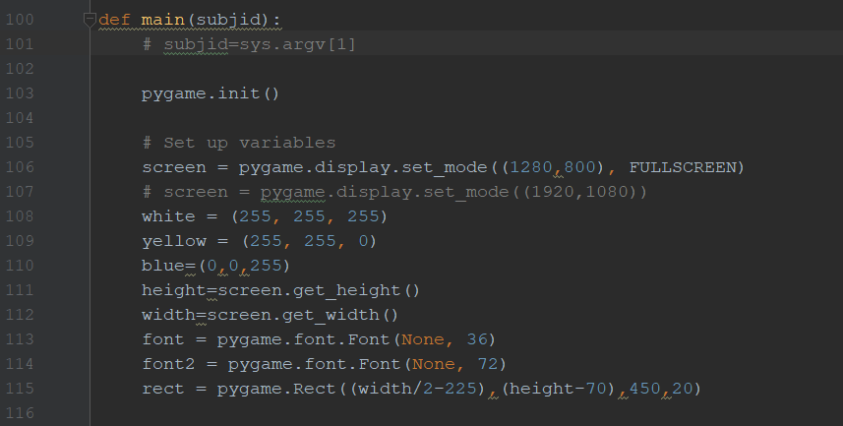
Made Executable
Before:
After:

Slide 7
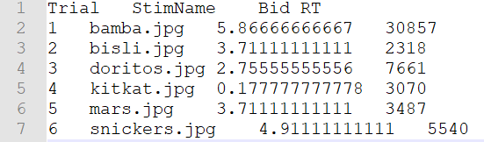
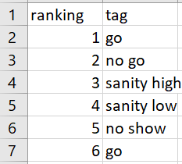
Input data
Output file of BDM (txt file)
Keys file (xlsx

Slide 8
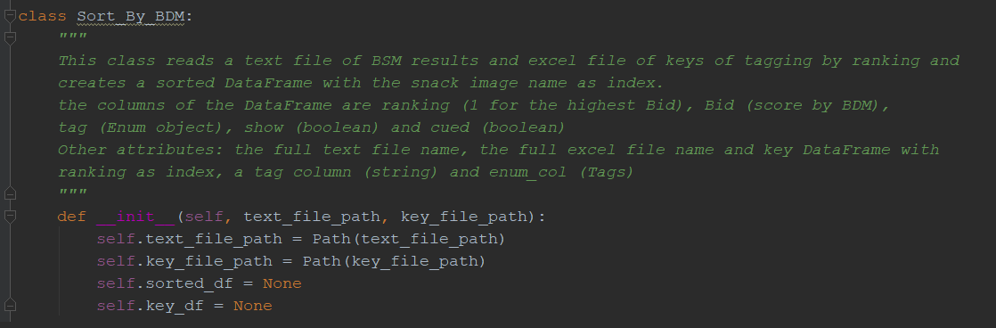
Class Sort_By_BDM

Slide 9
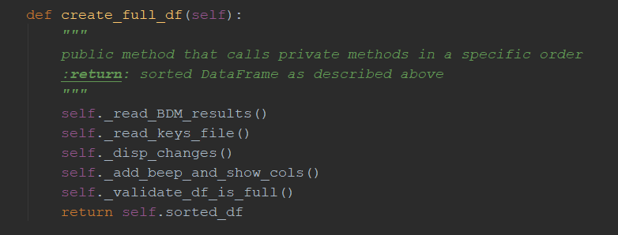
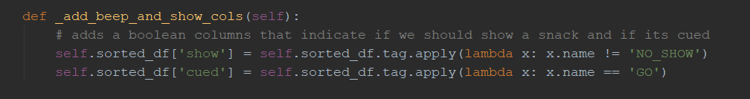
Public Vs. private Methods

Slide 10
Output

Slide 11
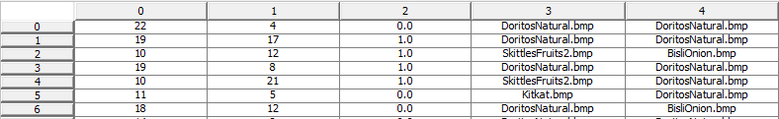
Probe Organization Function
Determines the comparisons that are shown in the probe
Uses Ido’s sorted BDM file determining which items’ identity
Creates random comparisons, every one of which is between a Go item and a No Go item
Go item index No Go item index left_go Go item No Go item

Slide 12
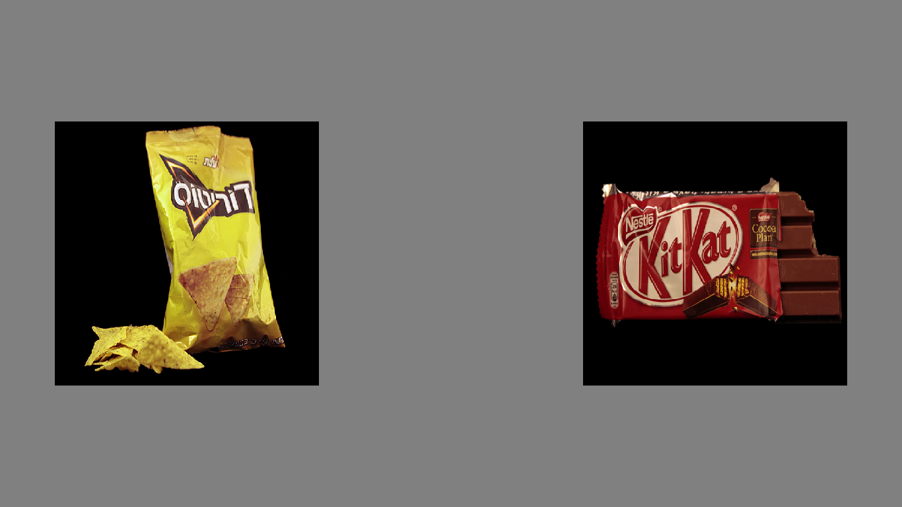
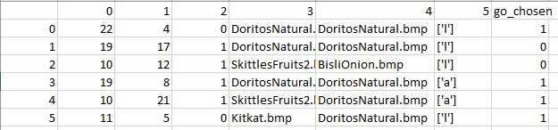
Probe Run Function
Runs the comparisons determined in the organization function
User responses (either ‘a’ or ‘l’ key), are recorded. The function saves a csv file containing all comparisons and their results, including a “go_chosen” column indicating whether the go item was selected in the comparison.

Slide 13
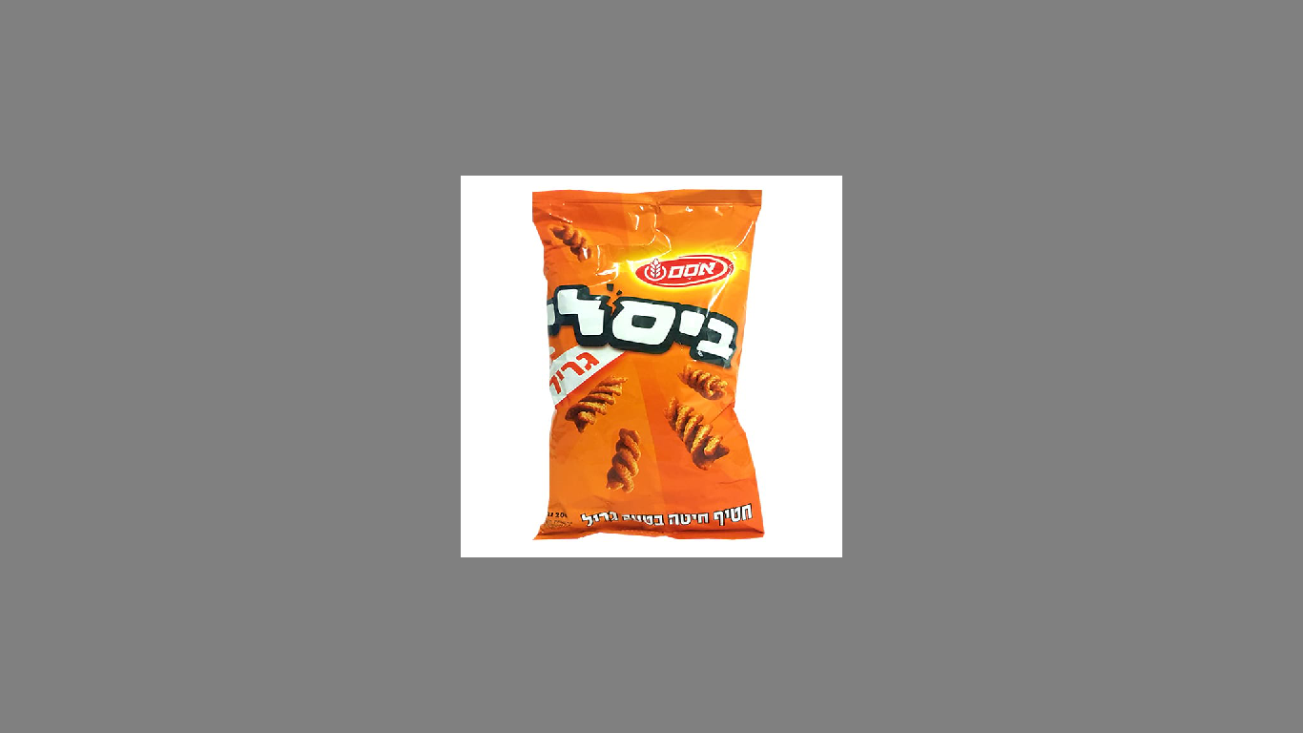
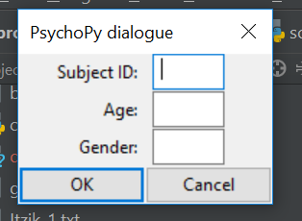
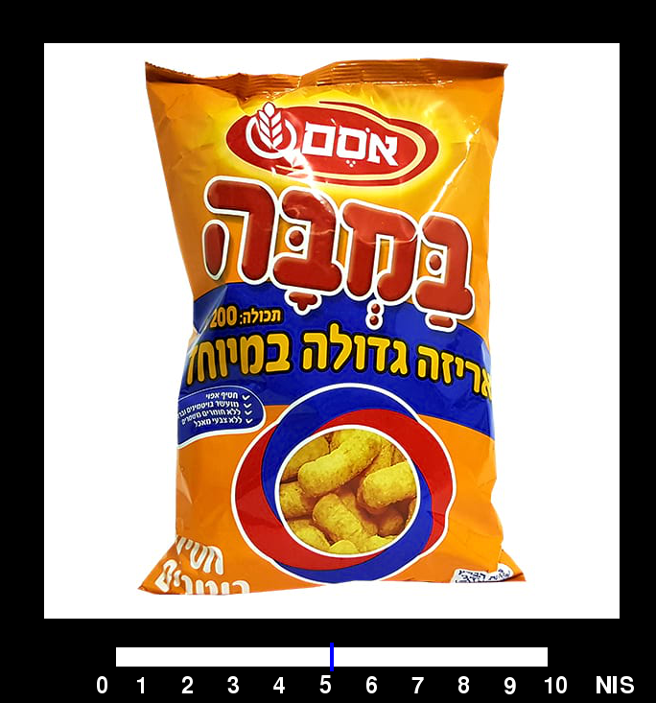
GUI Key Features

Slide 14
Main Challenges and Difficulties
BDM “black box” wasn’t really a black box and needed adjustments for next steps
Working on the same code piece -> a clear flowchart satisfied
Independent functions
Discovering Yaml

Slide 15
Concluding Remarks
Is the project usable?
Using independent classes and an output-input chain different
experiment features are easily modulated by experimenters
Freeing training/probe from matlab “chains”
The entire experiment can be executed on one platform
What’s left to do?
quit game at any time
limit success to specific key
tests

